Slide 1
DATA SPARK-ILLUMINATING INSIGHTS OF GLOBAL ELECTRONICS.
Presented by
DIDDHA DILEEP

Slide 2
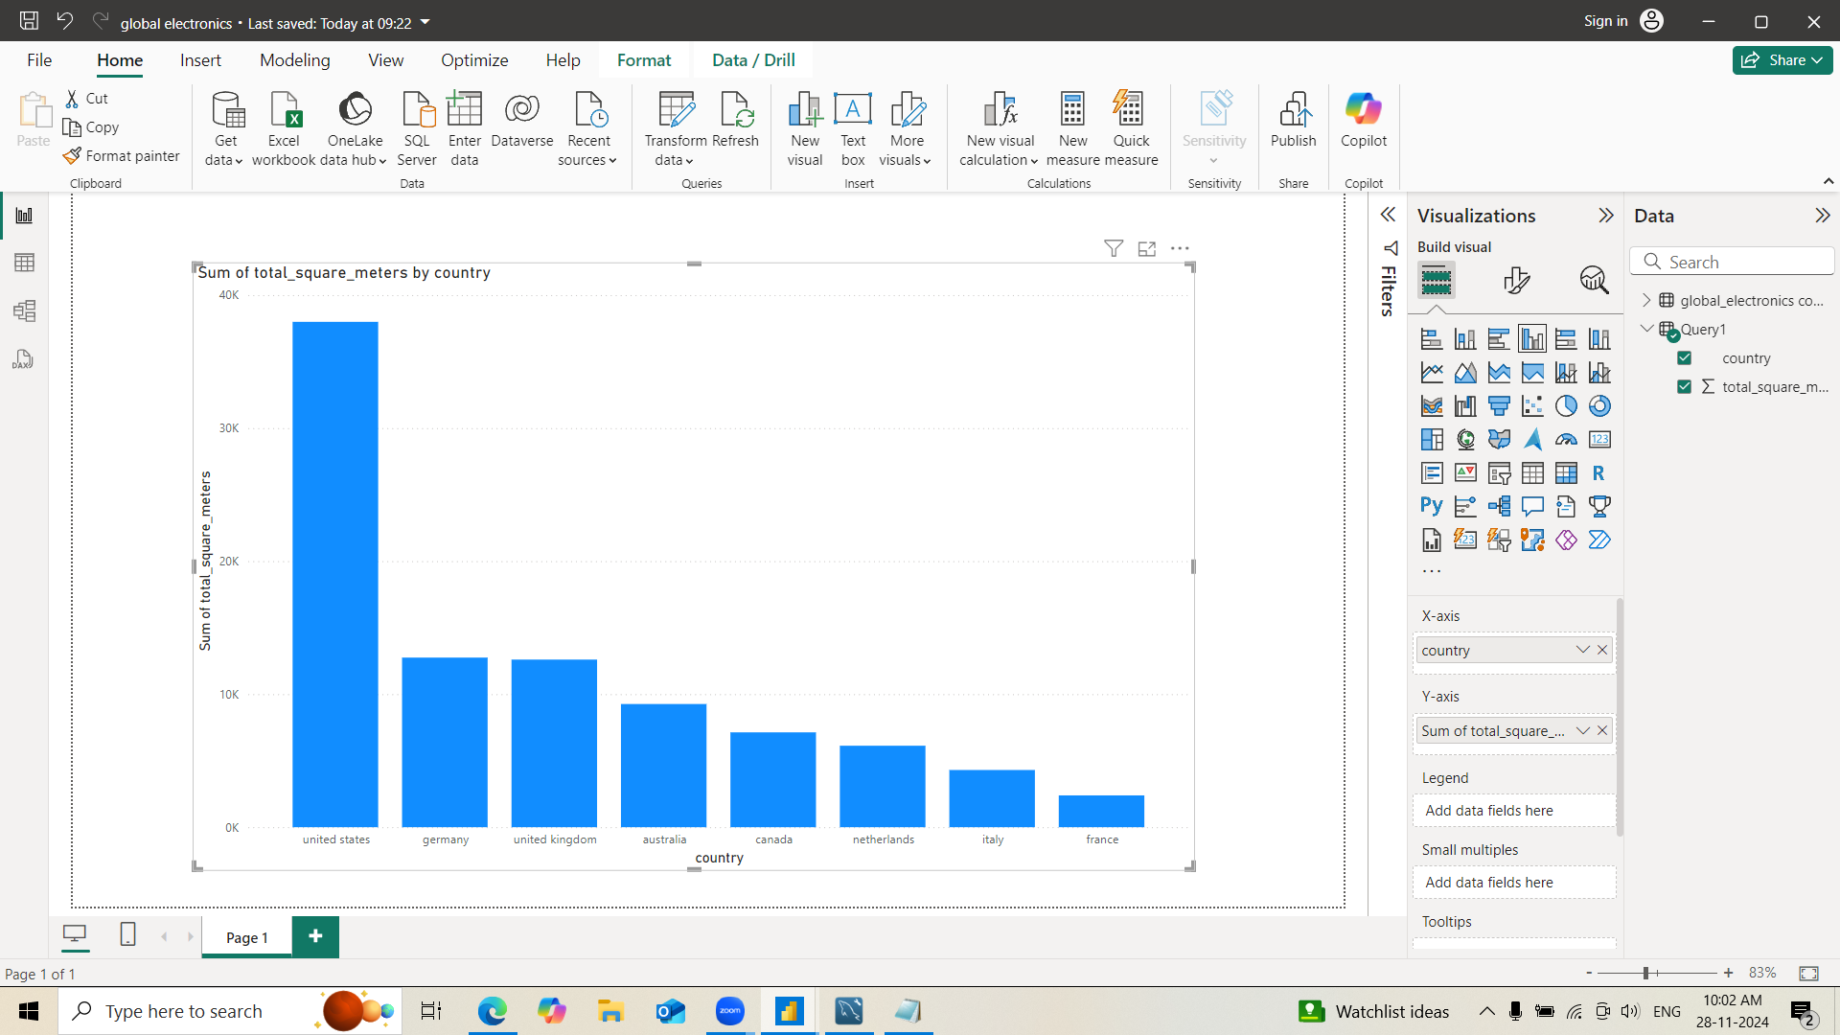
Total Square Metres of Stores by Country

Slide 3
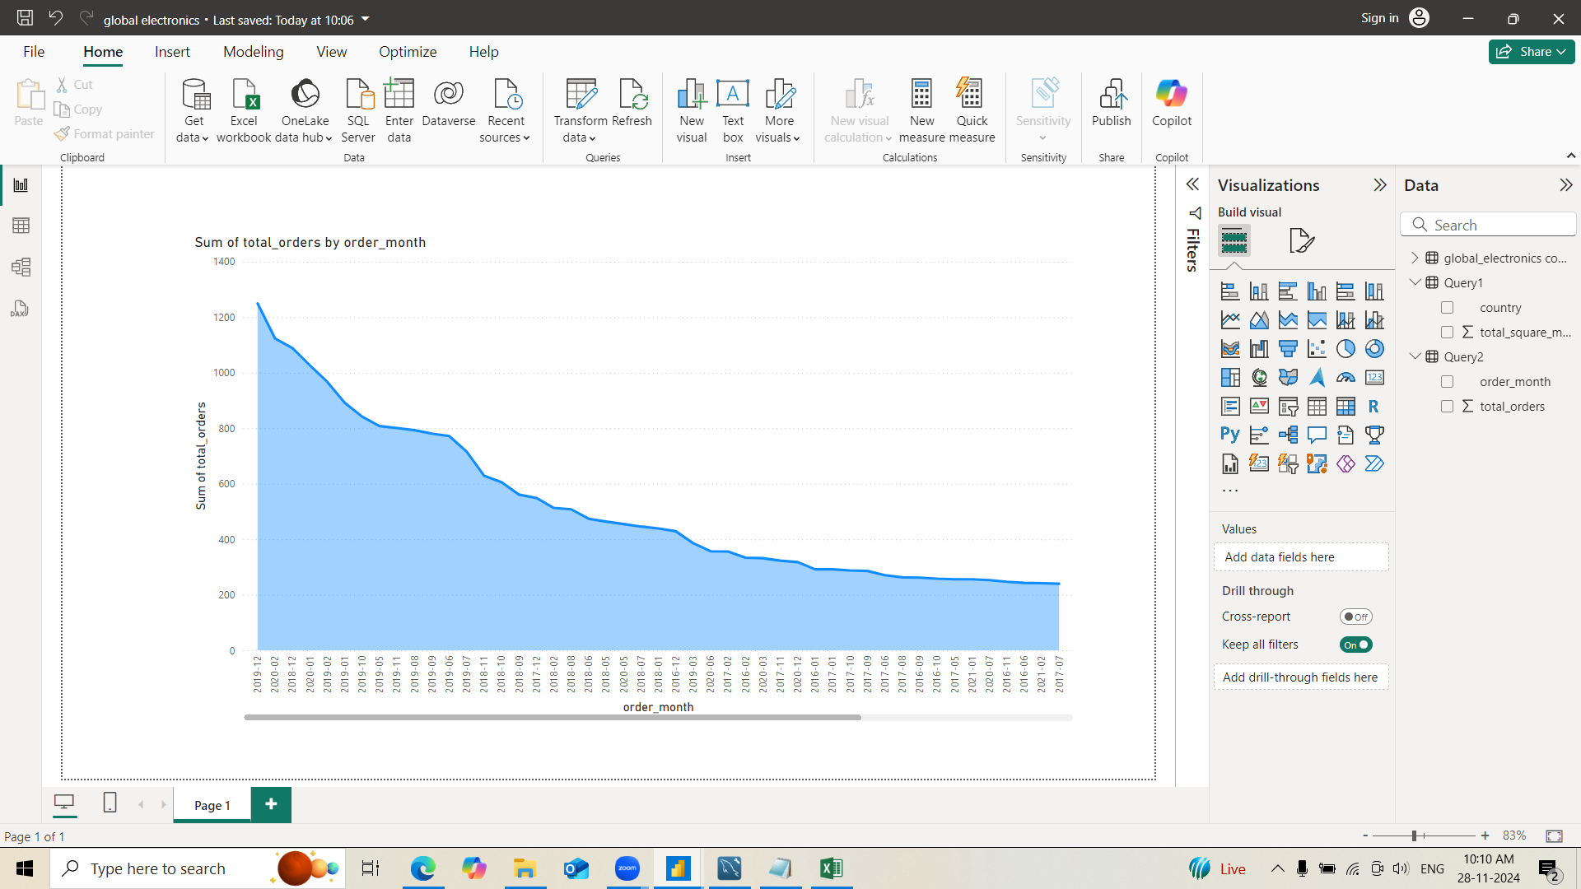
SUM OF TOTAL ORDERS PER MONTH

Slide 4
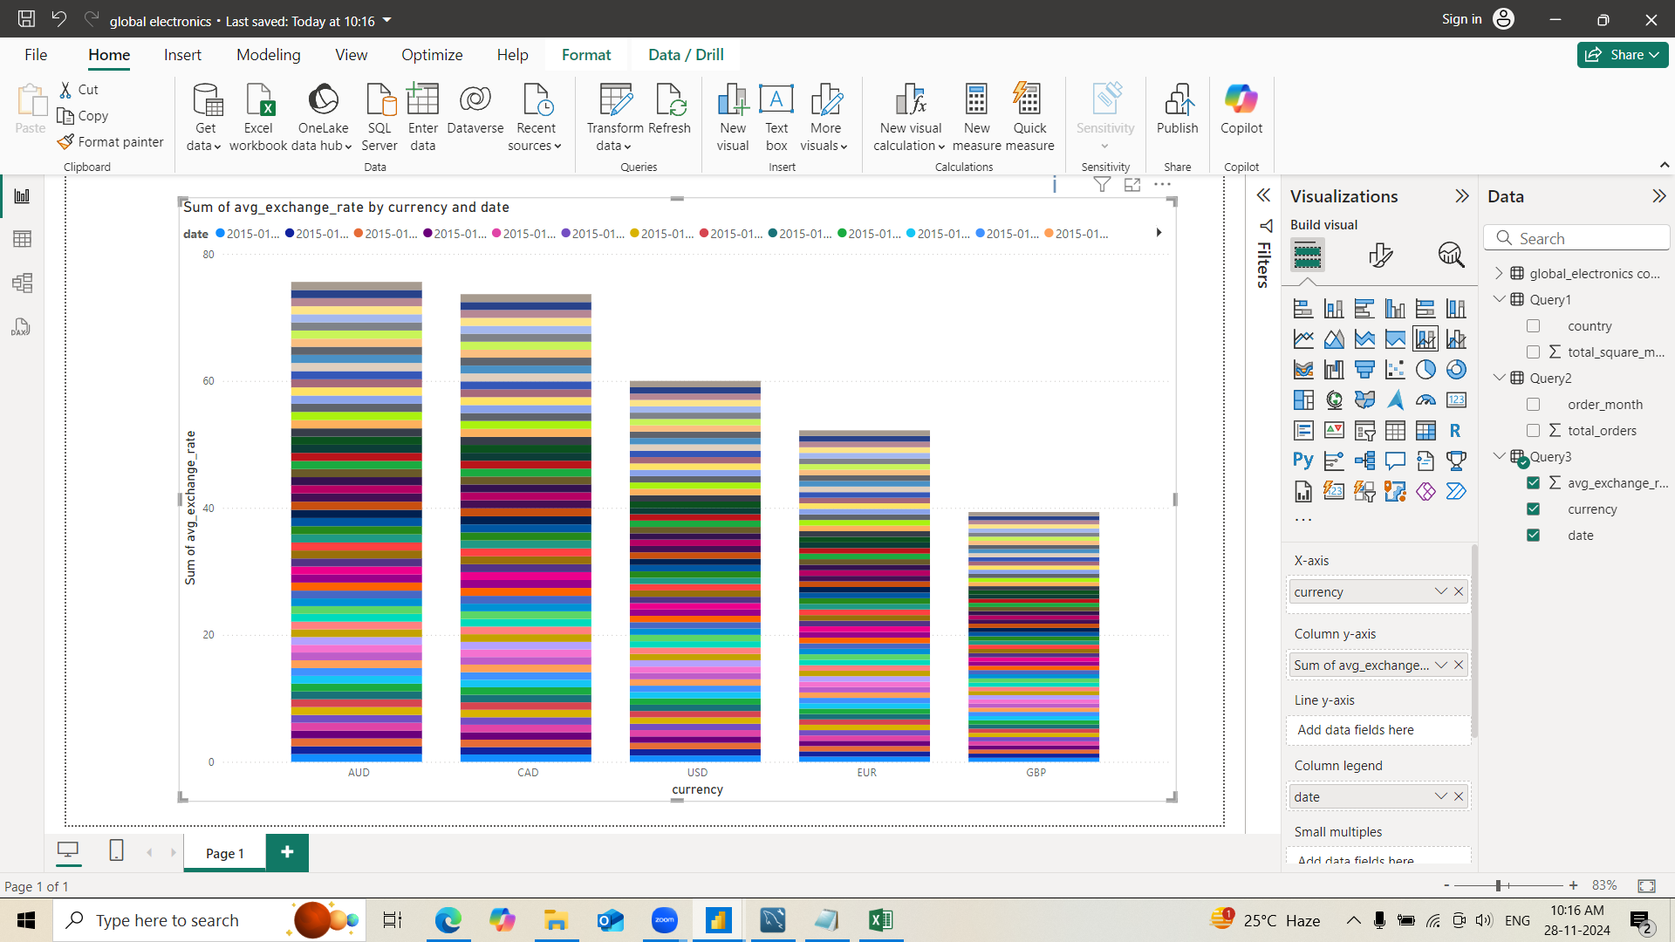
EXCHANGE RATE TRENDS

Slide 5
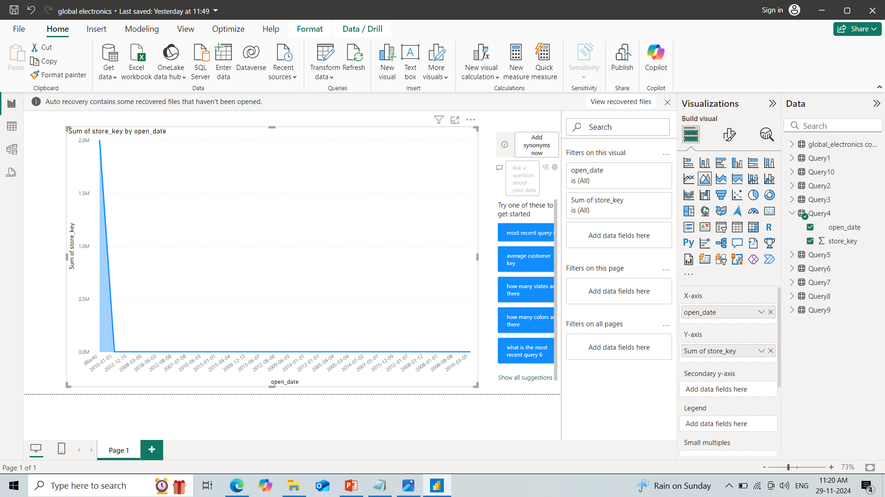
STORE OPEN DATES

Slide 6
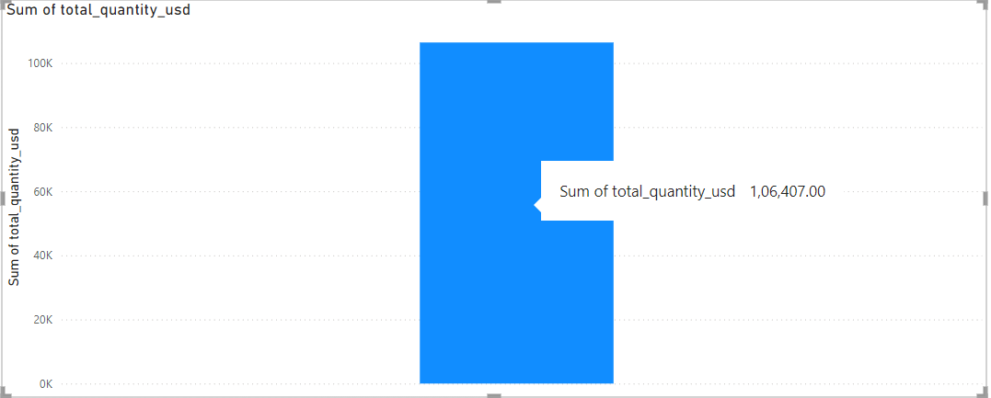
TOTAL QUANTITY SOLD IN USD CURRENCY

Slide 7
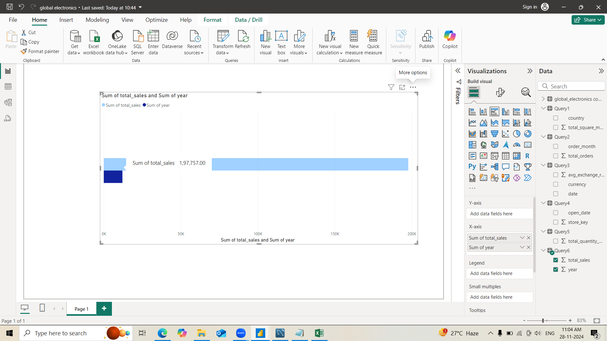
TOTAL SALES QUANTITY BY SUM OF YEAR

Slide 8
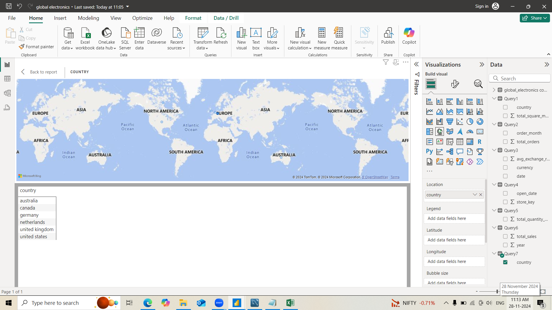
COUNTRIES WITH STORES OPENED AFTER 2015

Slide 9
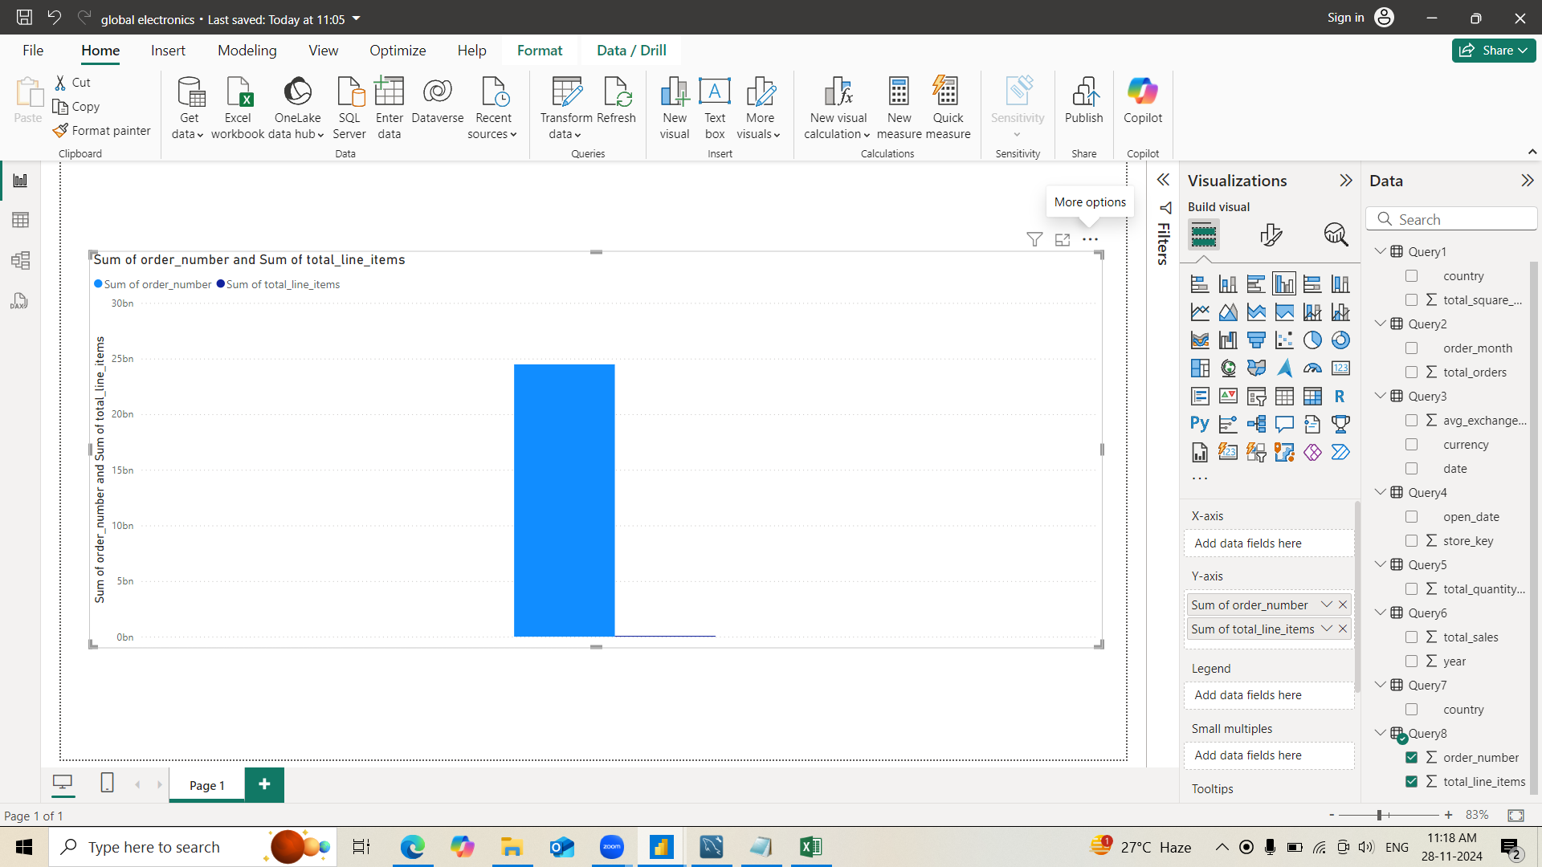
SUM OF ORDERS WITH MULTIPLE LINE ITEMS

Slide 10
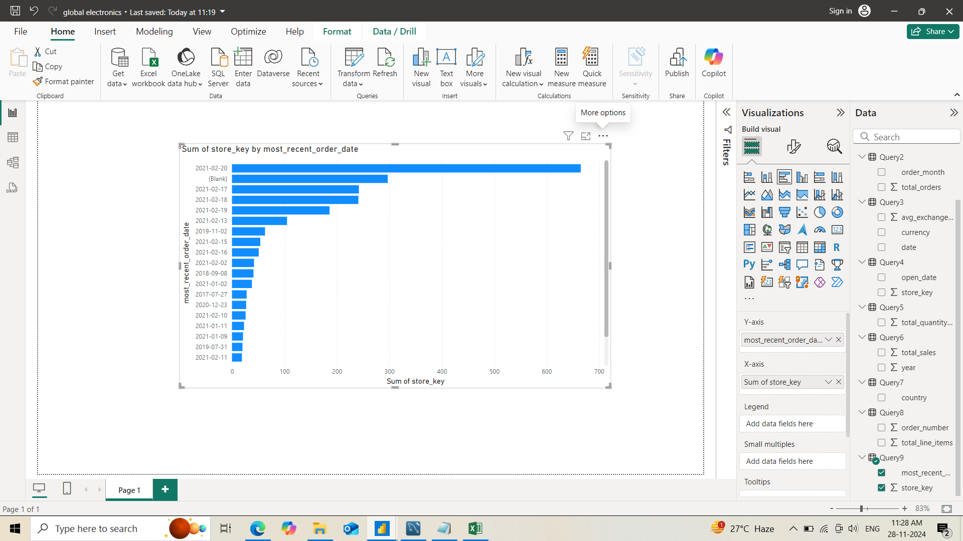
FETCH THE MOST RECENT ORDER OF EACH STORE

Slide 11
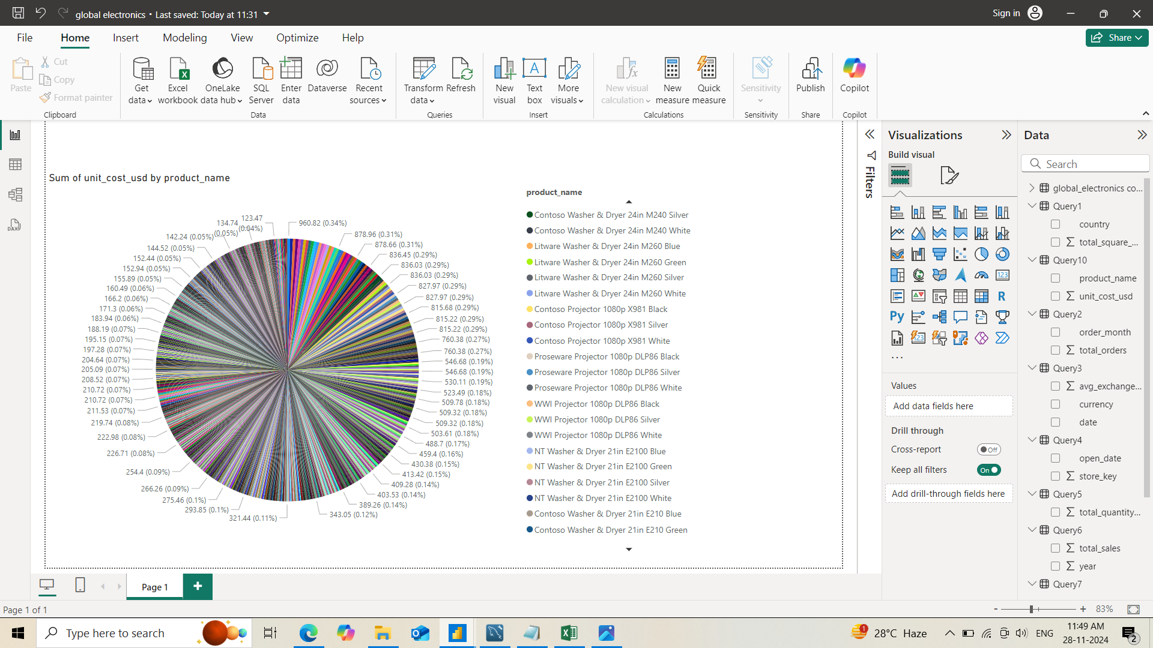
SUM OF TOTAL UNIT COST BY PRODUCT NAME

